Slide 1
Animator Research
Dannielle Smith

Slide 2
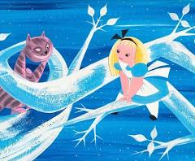
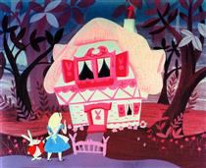
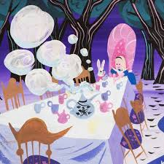
Historical animator
- Mary Blair
Mary Blair was a highly influential historical animator and concept artist at Walt Disney Studios, best known for shaping the visual style of Disney animation during the 1940s and 1950s. Her most significant contributions can be seen in films such as Cinderella (1950), Alice in Wonderland (1951), and Peter Pan (1953), as well as the theme park attraction It’s a Small World (1964).

Slide 3
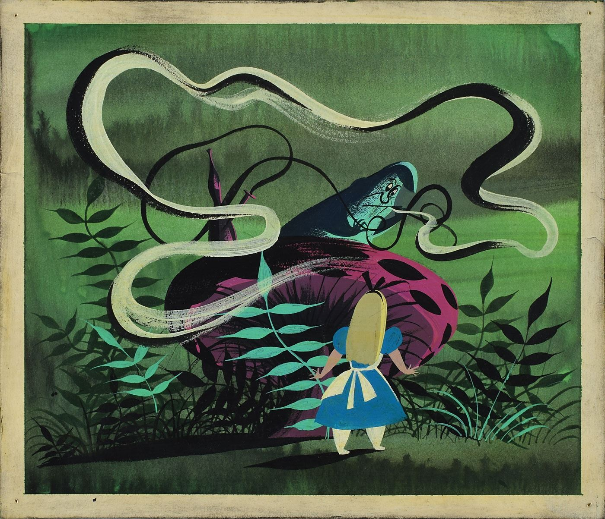
Historical animator - Mary Blair
Blair’s animation style is characterised by bold, vivid and expressive colour palettes, simplified shapes, minimised detail and strong compositions, allowing the viewers eye to be guided where she wanted it without being completely overwhelmed. Over-all her highly stylised art style, a stark contrast to Disney's more realistic animation style at the time. Mary Blair was also profoundly inspired by Latin American artwork, colours, and culture, which triggered a major, vibrant shift in her artistic style. Her work focused more on feeling and emotion, using colour and design to evoke a mood not just showing a scene at face value/literally.
A Great example of this is her work on Alice in Wonderland(1951). Mary Blair’s influence
on Alice in Wonderland is central to the film’s distinctive visual style and shows a major evolution/shift in the animation style at Disney. Blair introduced a highly stylised approach that
embraced abstraction, bold colours, and imaginative design. Her concept art shaped the surreal and dream-like environments of Wonderland, where scale, perspective, and colour are constantly changing to reflect Alice’s emotional journey rather than a physical reality. It’s the perfect movie to show just how impactful her designs and style was. Unnatural colours being used create an eerie, dreamlike atmosphere, reinforcing the narrative’s sense of confusion and fantasy. Backgrounds guiding the viewer’s eye and enhancing the movement of characters without overwhelming them with details, drawing visual focus where it needs to be.

Slide 4
Historical animator - Mary Blair
Blair worked primarily in concept art, influencing the final animation rather than animating frame-by-frame . Her designs guided other artists and animators working on these films, ensuring visual cohesion and consistency through-out a film. Her approach helped Disney transition from strict realism to more stylised and expressive visual storytelling.
Mary Blair’s influence on animation design is long-lasting. Her work demonstrates how colour, shape, and composition can communicate and enhance the emotions and narrative of an animation and not soly focus on character movement, realism and literal storytelling.
For my own work I would like to incorporate some of Blair’s style, experimenting with bold colour palettes, simplify backgrounds, and think about how visual design supports mood and storytelling rather than focusing soly on reality/realism.
References:
Canemaker, J. (2003). Mary Blair: The Art and Flair of Mary Blair. Disney Editions.
Disney Plus (2022). The Art of Disney Legend Mary Blair | Women's History Month | Disney+
Streacher, G. (2024). Examining the Legacy of Disney Artist Mary Blair. Alphaville: Journal of Film and Screen Media.

Slide 5
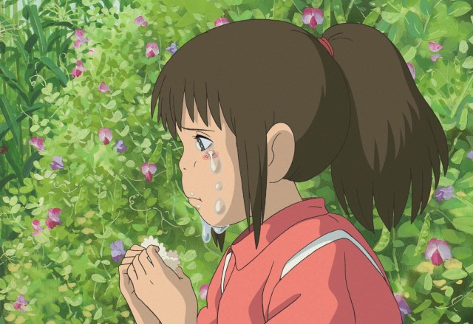
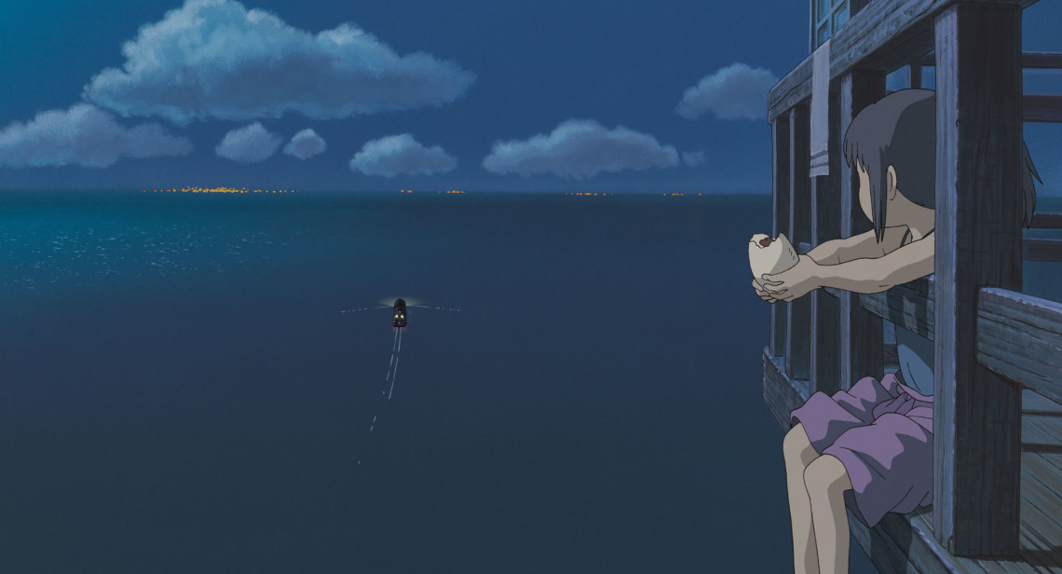
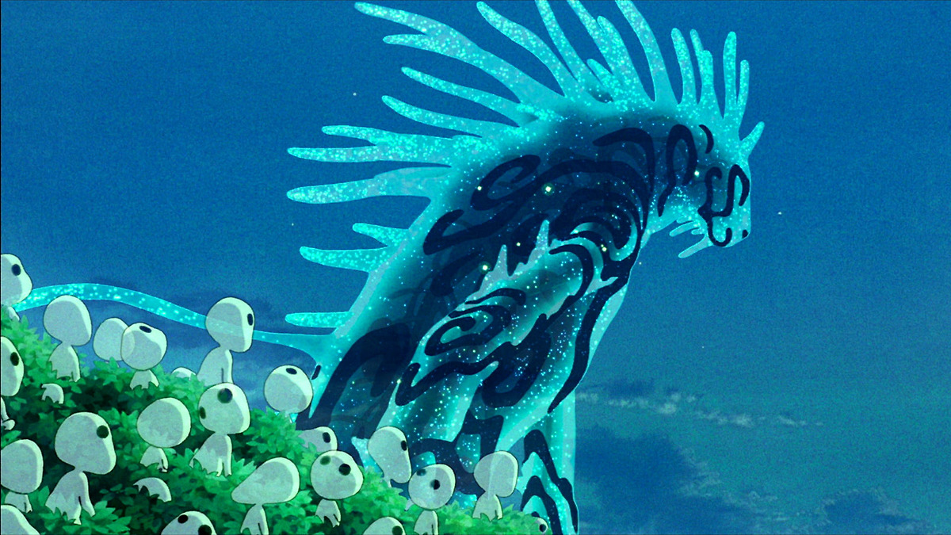
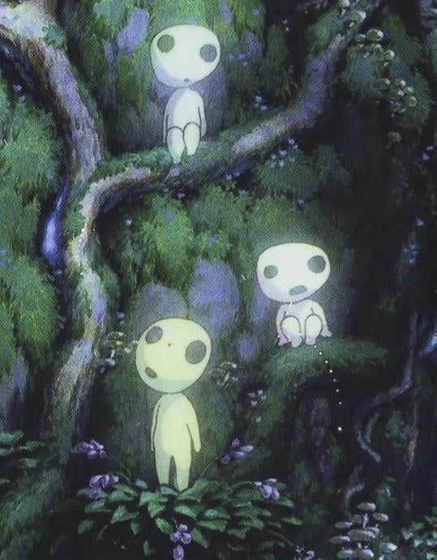
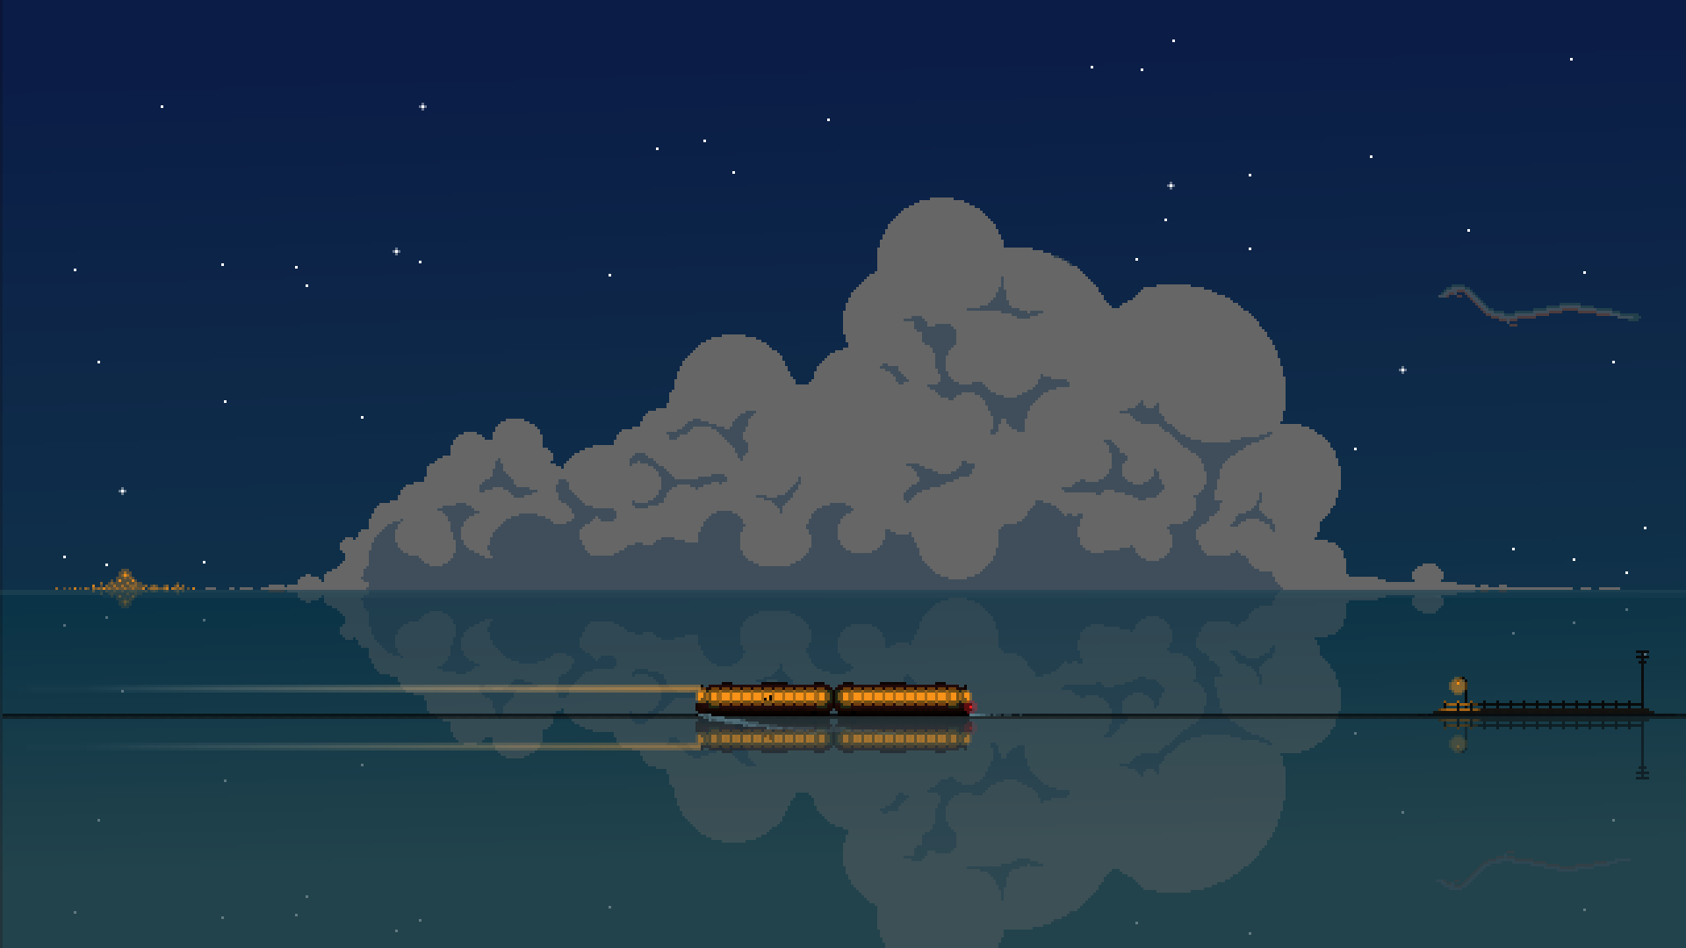
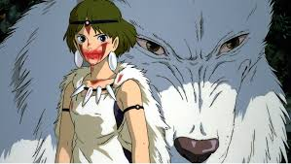
Contemporary Animator - Hayao Miyazaki
Hayao Miyazaki is a contemporary animator, director, and co-founder of Studio Ghibli, widely regarded as one of the most influential figures in modern animation and has been referred to as the "godfather of animation in Japan". His most significant works include Spirited Away (2001), My Neighbor Totoro (1988), and Princess Mononoke (1997).
Miyazaki’s animation style blends traditional detailed hand-drawn animation with rich environmental design and strong thematic storytelling. His animation style prioritises emotional realism, immersive world-building, and carefully observed subtle movements.

Slide 6
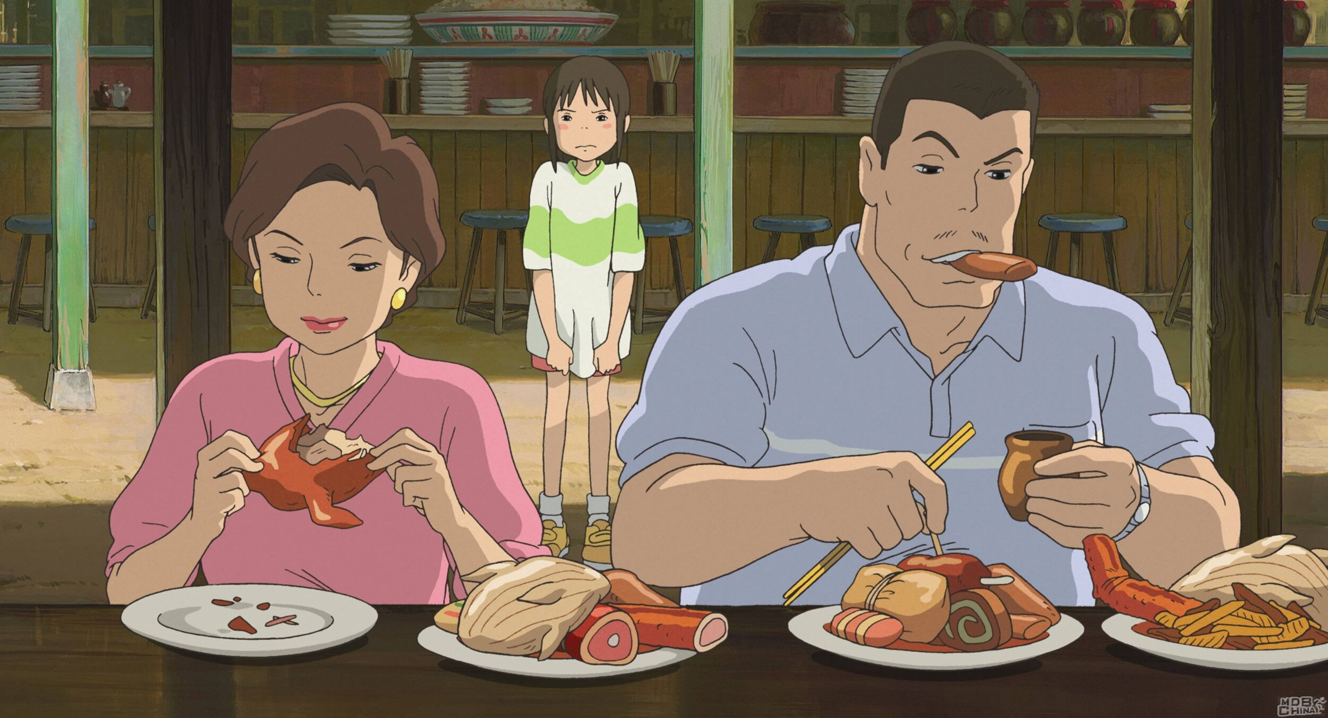
Contemporary Animator - Hayao Miyazaki
Miyazaki’s visual style is defined by highly detailed natural environments, expressive character animation, and a strong sense of movement and atmosphere. His animations emphasise subtle, everyday motions—such as wind moving through grass or characters pausing in silence—which add realism and emotional weight. (This technique is called “ma” -the use of negative space and pauses- allow scenes to breathe, making the world feel alive and believable.). Highlighting the beauty in the ordinary, and the familiarity in the fantastical.
Miyazaki commitment to traditional hand-drawn animation, even in an era
dominated by digital techniques. Helped to preserve and revitalise traditional 2D animation while pushing it forward thematically and technically, proving that hand-drawn animation could compete with CGI-dominated trends.
influencing global animation studios and inspiring a renewed appreciation for artisanal / traditional animation methods. The use of visual symbolism in his animations proved that animated films can address complex emotional and philosophical themes while remaining visually engaging and enjoyable for a wide range of audiences.

Slide 7
Contemporary Animator - Hayao Miyazaki
Because of Miyazaki’s I want to have more of a focus on environmental storytelling, make use of subtle movements, and allowing moments of stillness to enhance emotional impact. To me his films show that animation is not just about movement, but about creating believable worlds and meaningful experiences.
References:
McCarthy, H. (1999). Hayao Miyazaki: Master of Japanese Animation. Stone Bridge Press.
Greenberg, R. (2018). Hayao Miyazaki: Exploring the early Work of Japan's Greatest Animator. Bloomsbury.
Any-mation (2020). Hayao Miyazaki | The Mind of a Master.

Slide 8
Thank you

