Slide 1
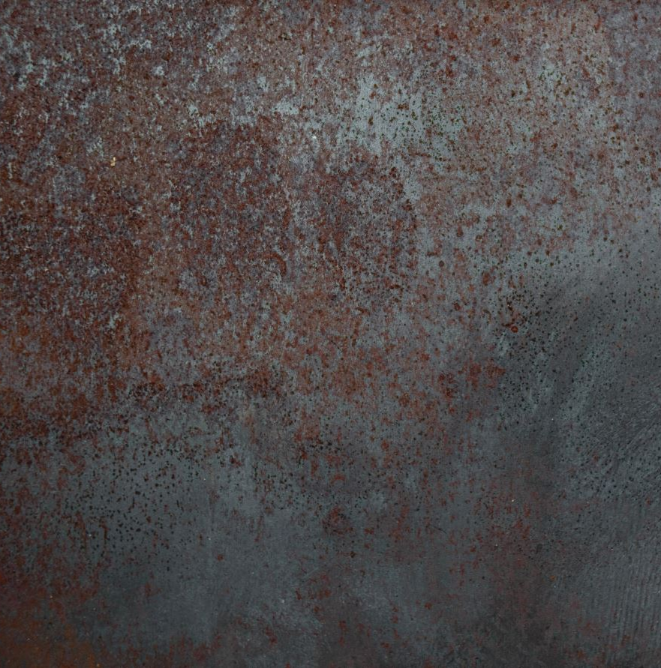
Honours project
Dannielle G. Smith
2101323

Slide 2
Intro & Changes

Slide 3
Question:
“Tool creation for an in-house engine:
How does one create a shader/post-processing tool for use in education?”
Why I chose this question?
-

Slide 4
Aim:
To create a shader tool in the form of a library to help developers and new programmers explore and use post-possessing effects effectively.
To have a step-by-step easy guide to an in-house engine tool that is easy to use and pick up.
Bring more awareness to the uses of graphics related programming.
Find a way that this plug-in could support education on graphics programming.

Slide 5
Objectives:
1.4.1. Objectives:
Shader Library Creation:
  Develop a library containing pre-built shaders that developers can easily apply, customize, and integrate into their own project/s.
  Provide simplified code/functions/etc to make shader usage more accessible.
Visual Shader Editor (GUI):
  Create intuitive GUI that enables users to create and modify shaders without needing extensive coding knowledge.
Real-Time Preview Feature:
  Implement a preview mode to visualize shader changes in real-time.
  Ensure the preview feature is only available in GUI mode and while the program is running.
Comprehensive Code Documentation:
  Offer built-in documentation and a separate PDF guide explaining the "how" and "why" of shader creation.
  Include step-by-step tutorials and explanations to guide users at all levels.
Optimized Performance:
  Ensure that the tool operates efficiently without negatively affecting performance.
Beginner-Friendly Design:
  Provide intuitive code and tools that even beginners can easily pick up and use within the first 15 minutes of experimentation.
Educational Value:
  Design the tool as an educational resource, helping users gain a basic understanding of post-processing effects and shader programming.
Accessibility Features for the UI
  High Contrast Mode and Colour Blindness: Does the tool offer high-contrast themes or colourblind-friendly modes to ensure visibility for users with different visual needs?
  Customizable Font Sizes/Layouts: Can the user adjust font sizes or UI scaling for better readability?

Slide 6
how the project has changed from Proposal.
The initial proposal envisioned a tool that would not only support the creation of shaders and post-processing effects but also include the ability to spawn/create particle effects, this was removed due to the broad scope and project complexity.
It has pivoted from a tool with potential for educational/awareness to a full-on educational tool and will now include documentation and tutorial features to support learners.

Slide 7
Risk Analysis: - what went wrong
Set out any major risks to the success of the project and describe how these could be mitigated, e.g.:
Tech issues
Game Engine updates
Lack of documentaion
Etc...

Slide 8
Demo & Docs

Slide 9

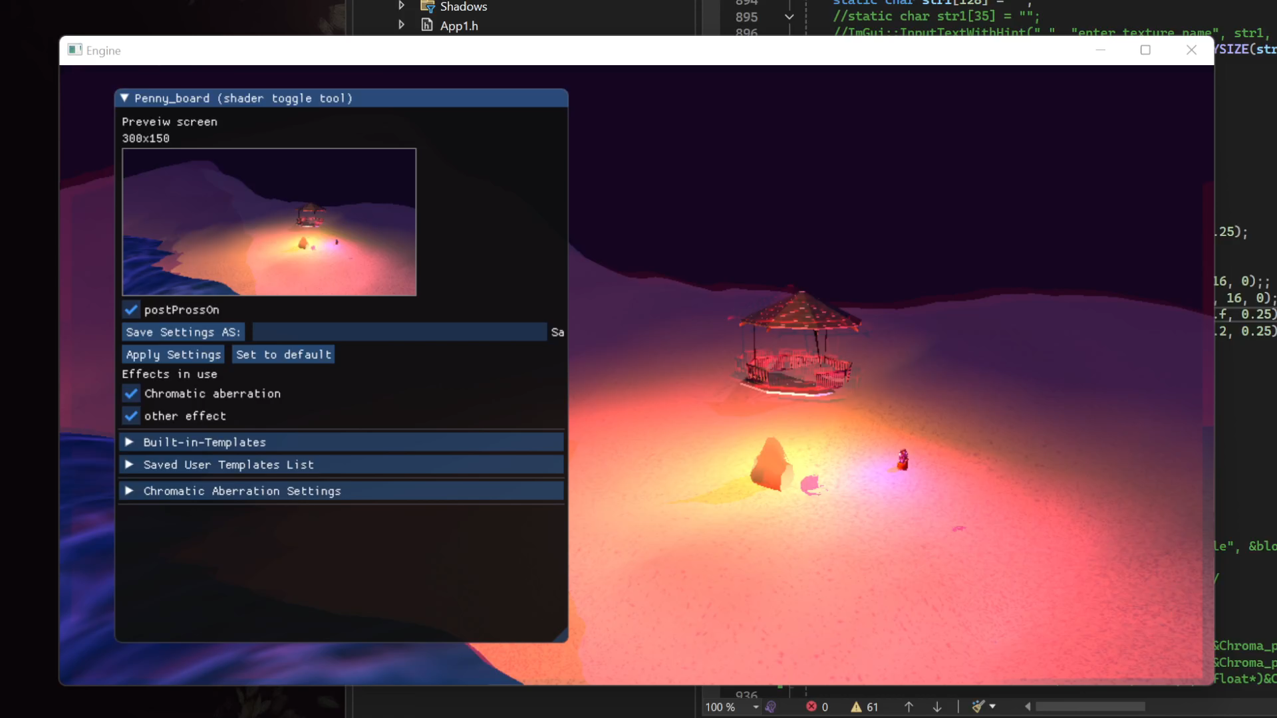
Demo prototype vs final project:
Text description about the demo:
What why how, justifying the way I went about things in the design and programming perspective.
(Play prototype)
Vs
Compare to final project.
(open exe & source code)
What has change & the difficulties of implementing them.

Slide 10
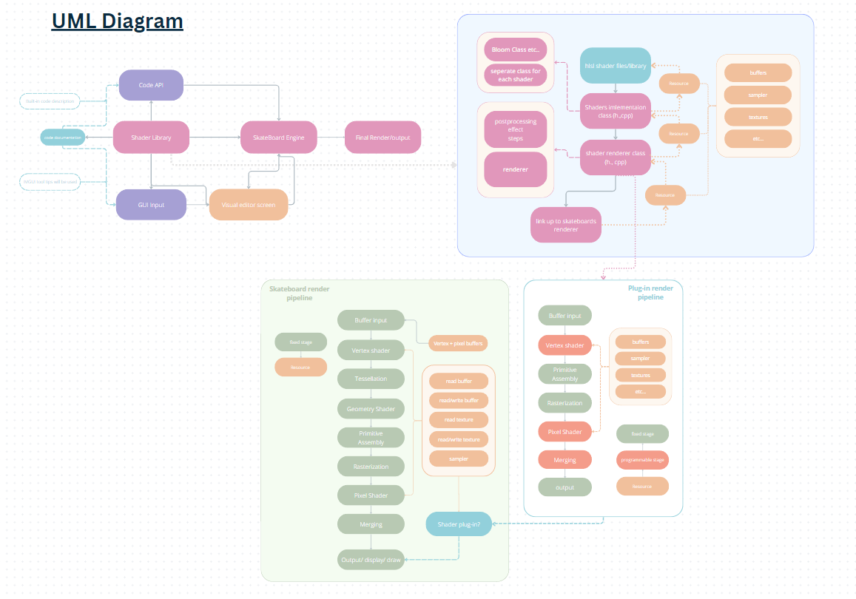
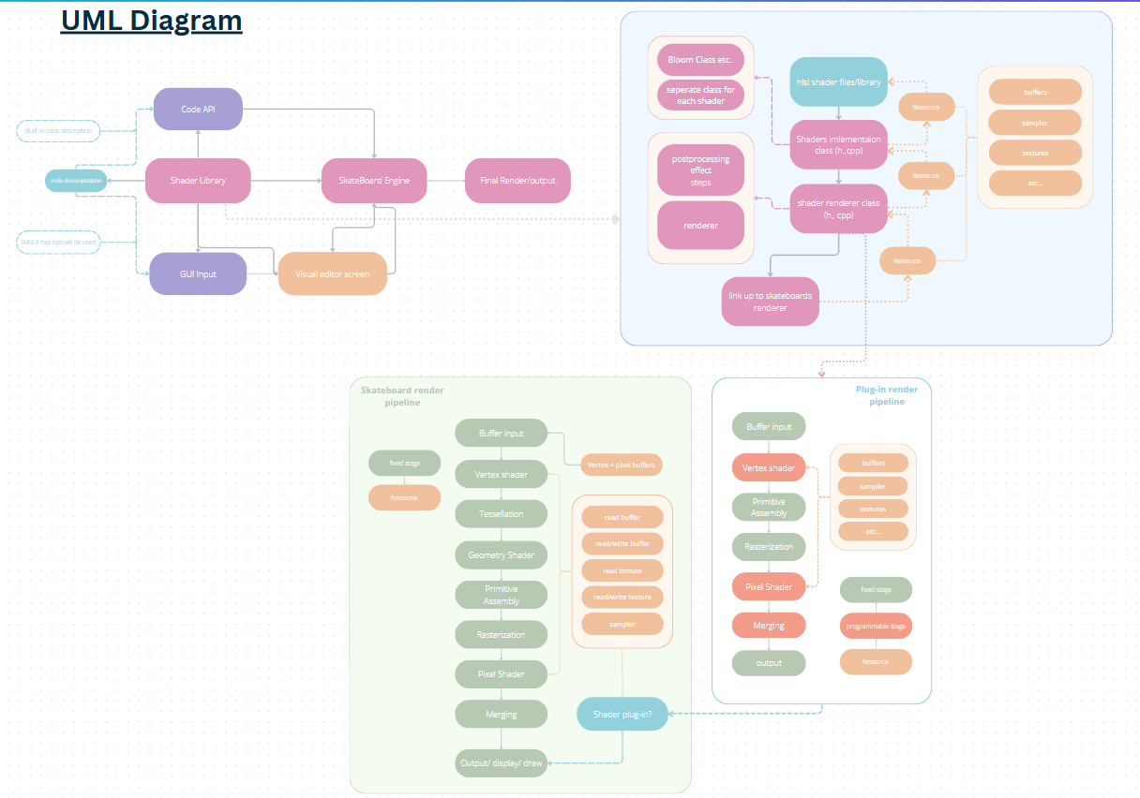
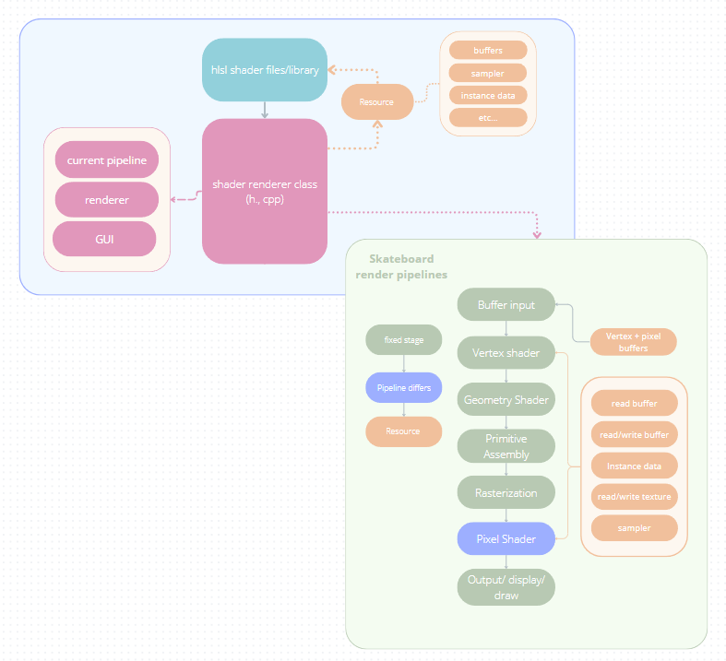
Old UML Diagram
& the way it differs from the current structure
Brief UML/
structural notes

Slide 11
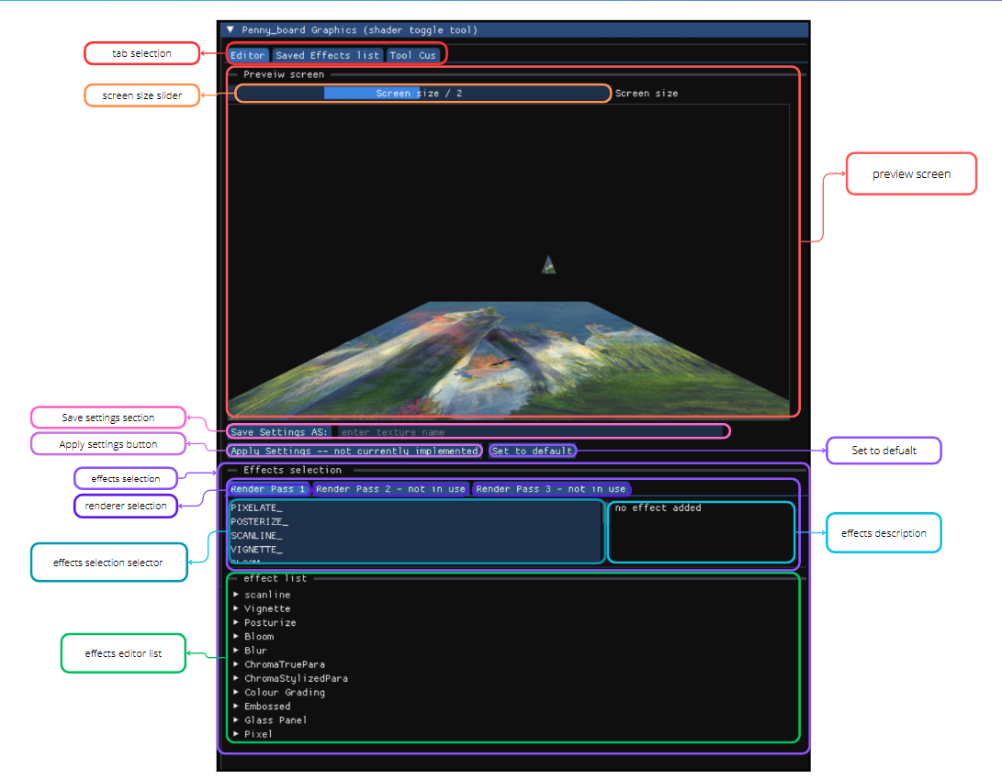
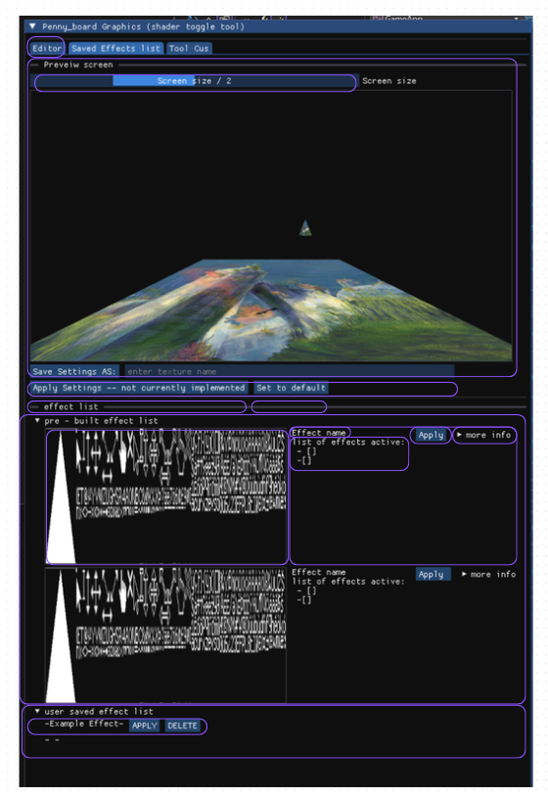
Documentation
Code examples with documentation text + GUI documentation using tool tips + a pdf link with the documentation
PennyboardPlug-in Manual_ honours.docx
.

Slide 12
Thank you for listening,
Questions?

